Slide 1
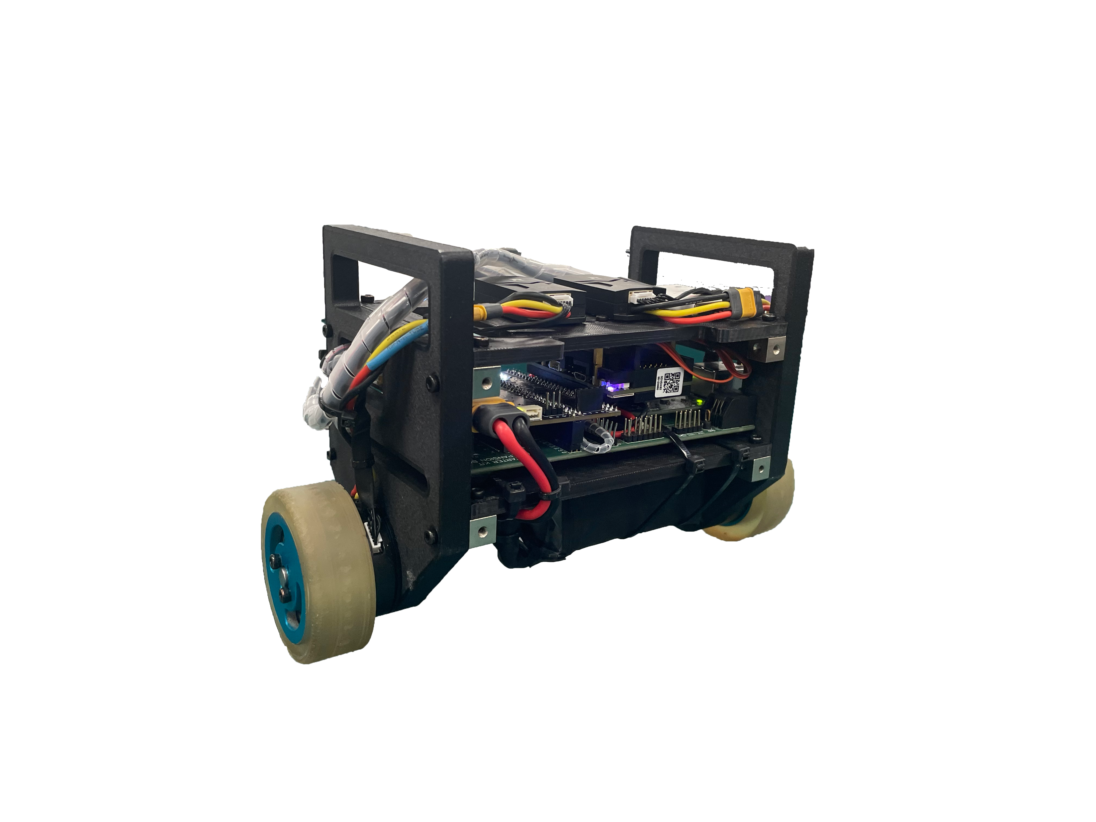

Smart two-wheel balanced robot
Objectives
High-level Description
Timeline
Shaoze Yang | priest-yang@sjtu.edu.cn
Yichen Wei | ethepherein@sjtu.edu.cn
Jiaming Yuan | jerry3012@sjtu.edu.cn

Slide 2
Description
Based on PIC32 Starter Kit, the design will have following features:
Use sensor data from gyroscope and accelerometer to do attitude calculation, thus change the speed of two wheels to realize self-balanced.
Receive control signal from 2.4GHz RadioMaster receiver.
Use buzzer to play music to alert nearby passengers.
Use ADC to read voltage of battery, and display battery status by LED lights.
If time allows, the system will be redesigned as a Wheeled Bipedal Robot, which will have two additional legs comparing to the current design.
Smart two-wheel balanced robot
Small and Light-weight: This robot has only two wheels and no complex mechanic structures, it's very small and therefore is capable of many extreme conditions.
Flexible and Fast: Without complex steering structure, it's very easy to change directions; Use high performance motor to gain high speed.
Safety aware: This robot will continuously play music, alerting the nearby passengers.
Objectives
Description
Timeline

Slide 3
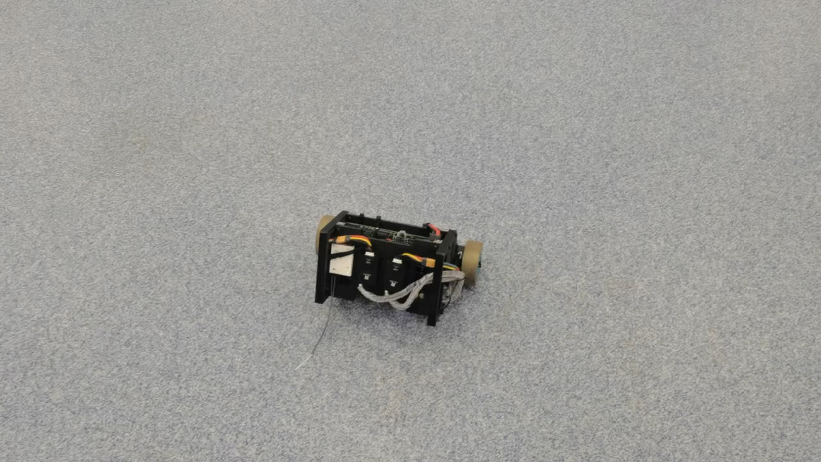
PID Control
use RadioMaster joystick to control remotely.
Smart two-wheel balanced robot
Objectives
Description
Timeline

Slide 4
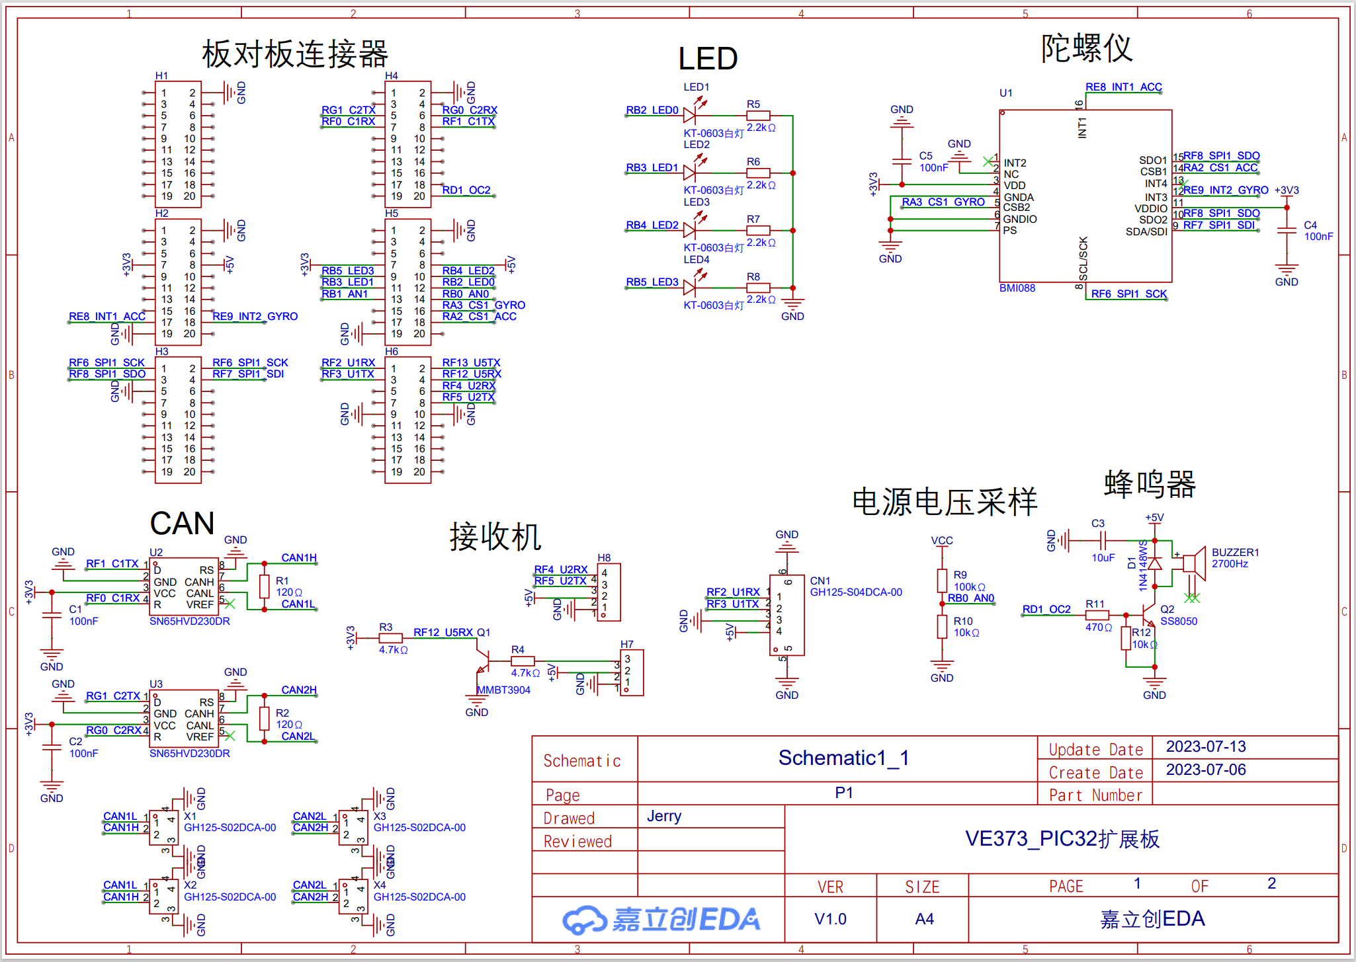
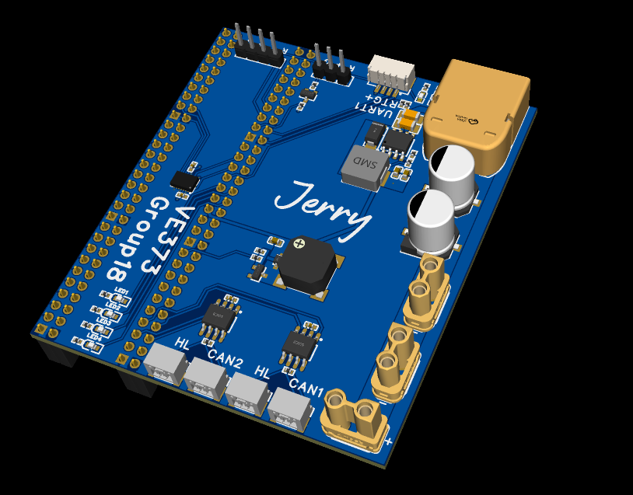
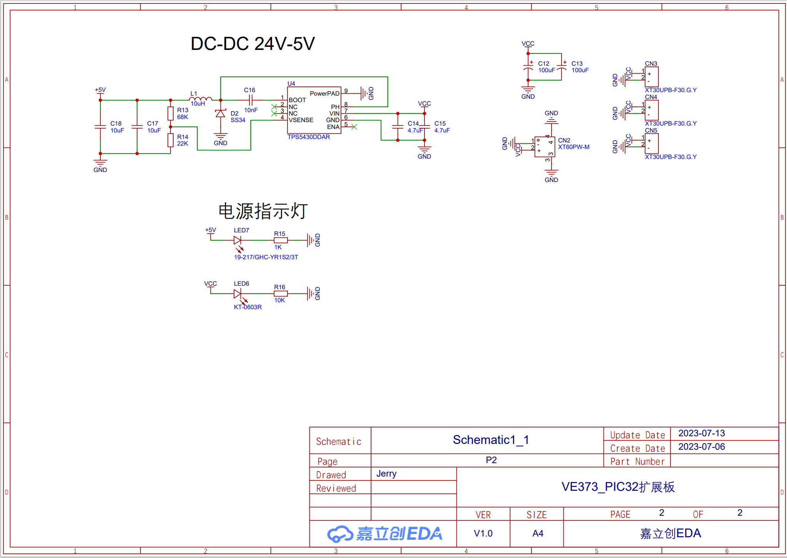

IO Expansion
Smart two-wheel balanced robot
Objectives
Description
Timeline
three PID controllers: a stand loop, a speed loop and a rotation loop
The stand loop will take the target pitch angle as the input, current pitch angle as the feedback and the target acceration (torque) as the output.
The speed loop and the rotation loop will take the user input and output to the stand loop.
The attitude (Euler angle) of the robot is calculated by Mahony algorithm.

Slide 5
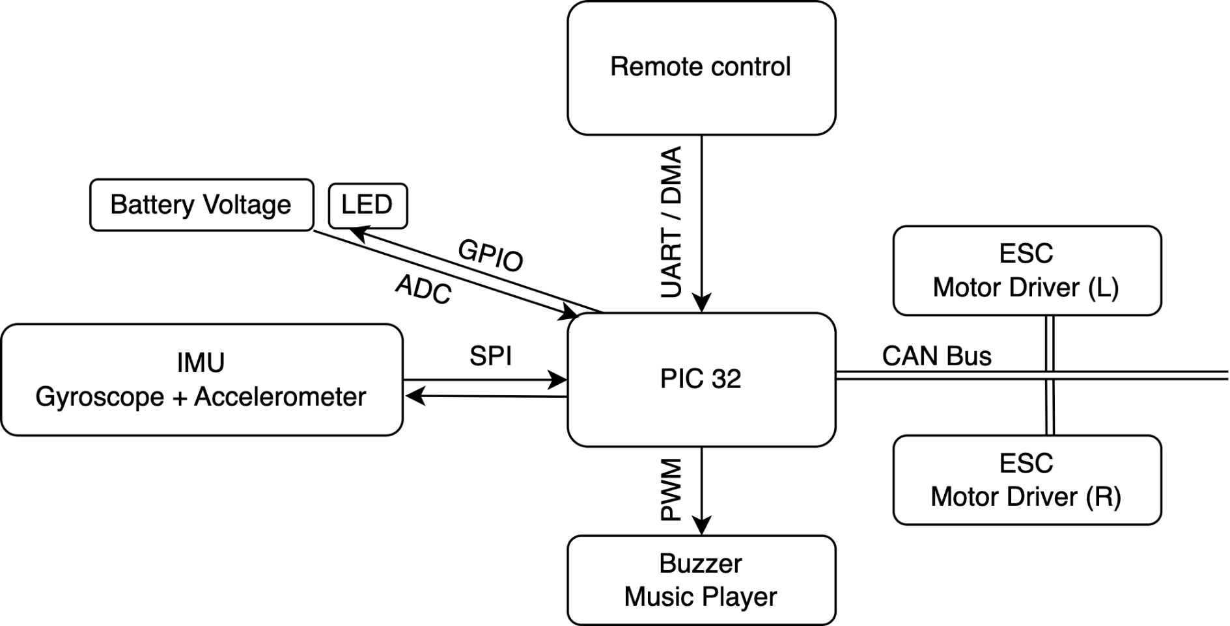
Primary MCU peripherals
Smart two-wheel balanced robot
CAN Bus
CAN Bus
Objectives
Description
Timeline
three PID controllers: a stand loop, a speed loop and a rotation loop
The stand loop will take the target pitch angle as the input, current pitch angle as the feedback and the target acceration (torque) as the output.
The speed loop and the rotation loop will take the user input and output to the stand loop.
The attitude (Euler angle) of the robot is calculated by Mahony algorithm.

Slide 6
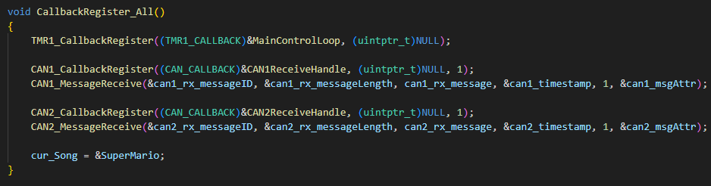
Primary MCU peripherals
Timers and Interrupts
Smart two-wheel balanced robot
Timer1: 1ms period to generate a 1000Hz interrupt
Most operations will be handled in the function registered for the int
CAN: Two interrupts for receive FIFO
Objectives
Description
Timeline
three PID controllers: a stand loop, a speed loop and a rotation loop
The stand loop will take the target pitch angle as the input, current pitch angle as the feedback and the target acceration (torque) as the output.
The speed loop and the rotation loop will take the user input and output to the stand loop.
The attitude (Euler angle) of the robot is calculated by Mahony algorithm.

Slide 7
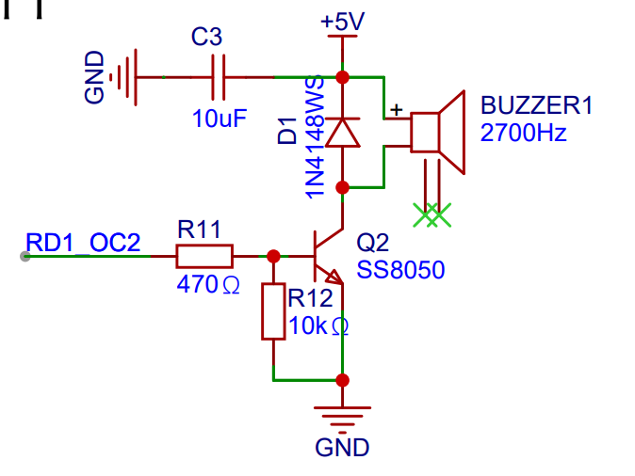
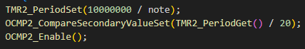
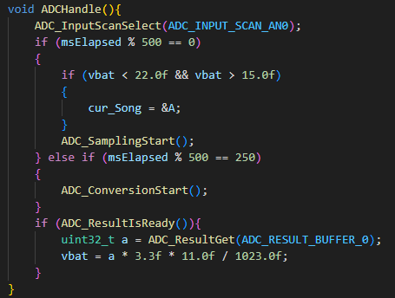
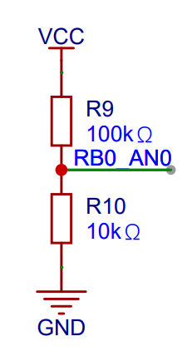
Primary MCU peripherals
Timers, PWM and ADC
Smart two-wheel balanced robot
Timer2: Dynamic period for specific note frequency
OCMP2: PWM generation mode for driving a buzzer
ADC: Sensing the input battery voltage for giving alert to low battery
Objectives
Description
Timeline
three PID controllers: a stand loop, a speed loop and a rotation loop
The stand loop will take the target pitch angle as the input, current pitch angle as the feedback and the target acceration (torque) as the output.
The speed loop and the rotation loop will take the user input and output to the stand loop.
The attitude (Euler angle) of the robot is calculated by Mahony algorithm.

Slide 8
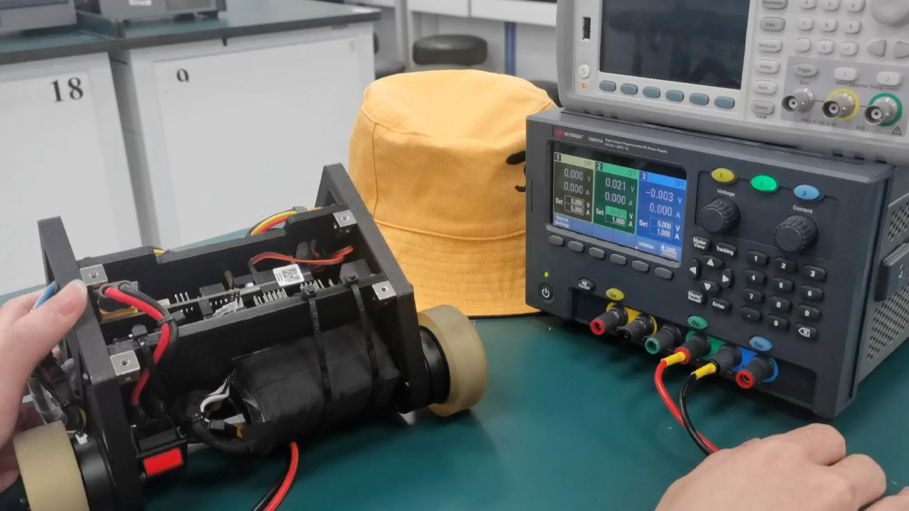
Primary MCU peripherals
Smart two-wheel balanced robot
Objectives
Description
Timeline
three PID controllers: a stand loop, a speed loop and a rotation loop
The stand loop will take the target pitch angle as the input, current pitch angle as the feedback and the target acceration (torque) as the output.
The speed loop and the rotation loop will take the user input and output to the stand loop.
The attitude (Euler angle) of the robot is calculated by Mahony algorithm.

Slide 9
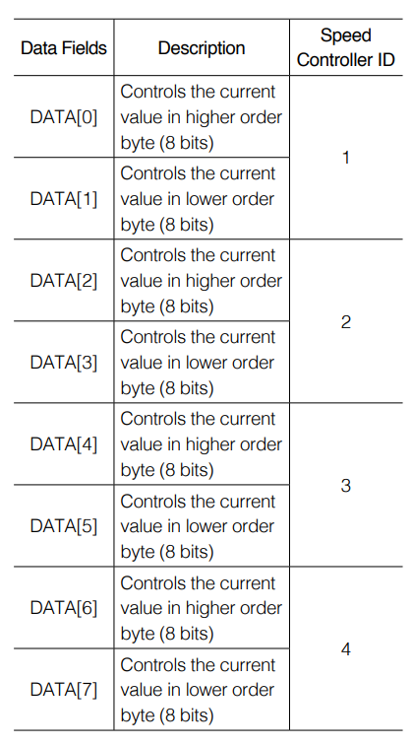
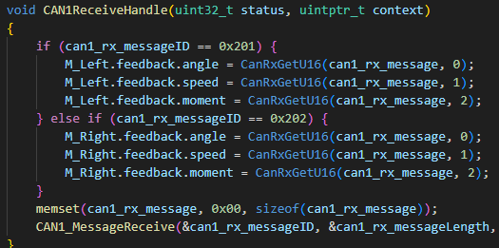
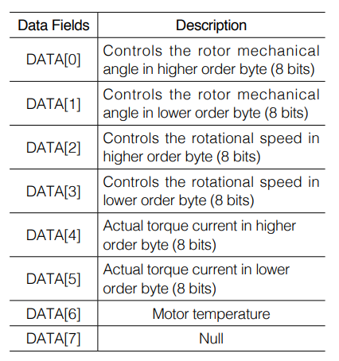
Primary MCU peripherals
CAN Bus
Smart two-wheel balanced robot
CAN1:
Transmit:
ID 0x200: Target intensity of the motors
Receive:
ID 0x201: Feedback of the Left motor
ID 0x202: Feedback of the Right motor
Objectives
Description
Timeline
three PID controllers: a stand loop, a speed loop and a rotation loop
The stand loop will take the target pitch angle as the input, current pitch angle as the feedback and the target acceration (torque) as the output.
The speed loop and the rotation loop will take the user input and output to the stand loop.
The attitude (Euler angle) of the robot is calculated by Mahony algorithm.

Slide 10
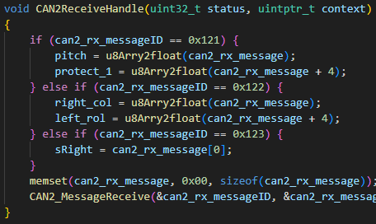
Primary MCU peripherals
CAN Bus
Smart two-wheel balanced robot
CAN2:
Receive: from an external module with an IMU and receiver
ID 0x121: Pitch angle from the IMU and a sum of 3-axis angular velocity
ID 0x122: Remote controller stick volume
ID 0x123: Remote controller stick state
Objectives
Description
Timeline
three PID controllers: a stand loop, a speed loop and a rotation loop
The stand loop will take the target pitch angle as the input, current pitch angle as the feedback and the target acceration (torque) as the output.
The speed loop and the rotation loop will take the user input and output to the stand loop.
The attitude (Euler angle) of the robot is calculated by Mahony algorithm.

Slide 11
Smart two-wheel balanced robot
Group 18
Thanks for your listening!
Shaoze Yang | priest-yang@sjtu.edu.cn
Yichen Wei | ethepherein@sjtu.edu.cn
Jiaming Yuan | jerry3012@sjtu.edu.cn

